Slide 1

COMP 53 – Week Four
Inheritance

Slide 2
Lab 2 Review
Complete lab (if needed)
Review solution

Slide 3
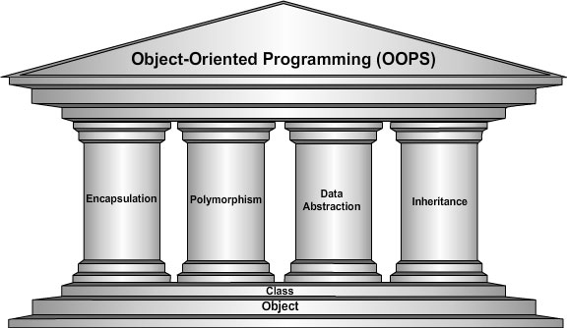
Topics
Simple Inheritance
Constructors and Destructors
Private Parts revisited

Slide 4
Why Do We Care
Adds another “dimension” to OOP. Data abstraction contains both polymorphism and inheritance.
Better than copy → paste
Single version of primary class code
Only change what’s different

Slide 5
Inheritance Basics
New class inherited from another class
Base class
"General" class from which others derive
Derived class
New class
Automatically has base class’s:
Member variables
Member functions
Can then add additional member functions and variables

Slide 6
Speak the Language!
Ancestor
Parent
Child1
Child2
Child3
AKA Base Class
Derives properties and methods from parent
Also called descendants

Slide 7
Derived Classes
General employee class. No objects will be defined at this level. But all related data can be specified
Employee
ID
Name
SSN
Pay
------------------------
getName()
getPay()
printCheck()
Salary Employee
annualWage
------------------------
getName()
setSalary()
Hourly Employee
hourWage
------------------------
setHourRate
Notes:
Consider example: Class of "Employees"
Composed of:
Salaried employees
Hourly employees
Each is "subset" of employees
Another might be those paid fixed wage each month or week

Slide 8
Employee Class
Consider printCheck() function:
Will always be "redefined" in derived classes
So different employee types can have different checks
Makes no sense really for "undifferentiated" employee
So function printCheck() in Employee class says just that
Error message stating "printCheck called for undifferentiated employee!! Aborting…"

Slide 9
Deriving from Employee Class
Derived classes from Employee class:
Automatically have all member variables
Automatically have all member functions
Derived class said to "inherit" members from base class
Can then redefine existing members and/or add new members

Slide 10
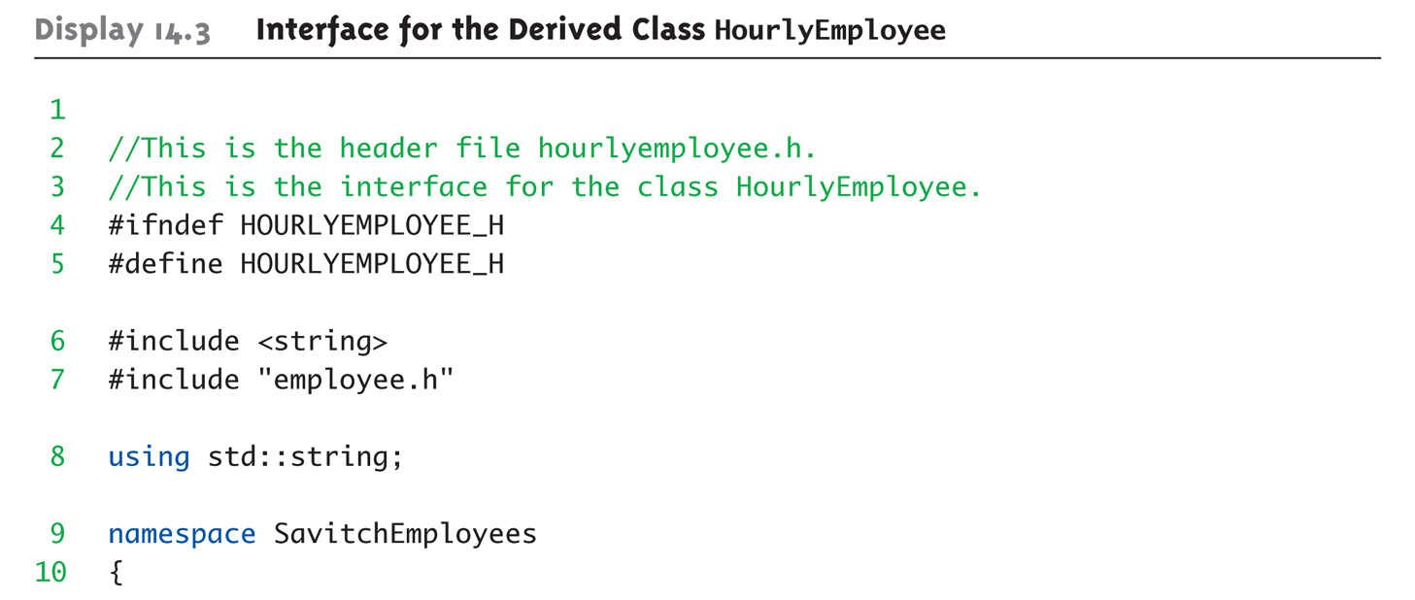
Interface for the Derived Class HourlyEmployee (1 of 2)
Need to include parent class header file

Slide 11
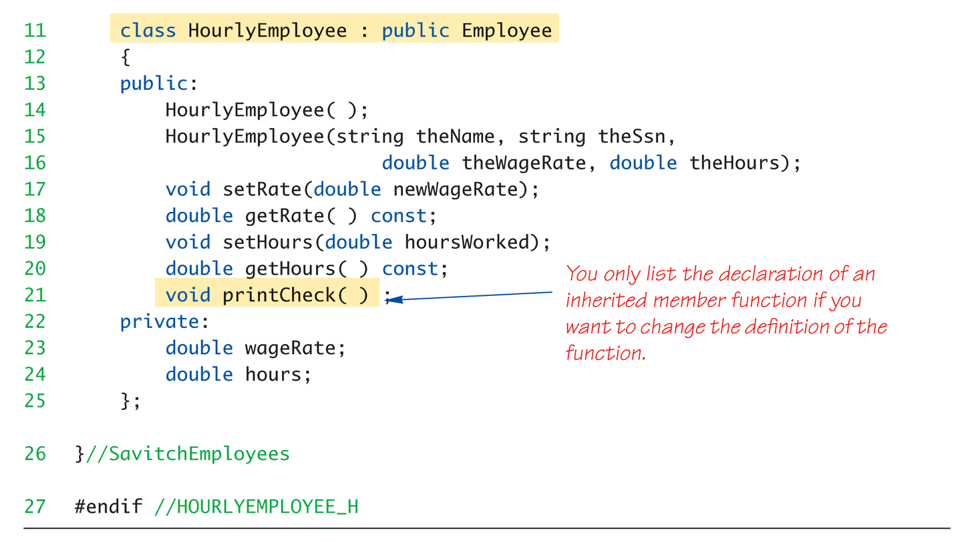
Interface for the Derived Class HourlyEmployee (2 of 2)
Derived class syntax is newClass : parentClass
New methods
Notes:
Derived class interface only lists new or "to be redefined" members
Since all others inherited are already defined
i.e.: "all" employees have ssn, name, etc.
HourlyEmployee adds:
Constructors
wageRate, hours member variables
setRate(), getRate(), setHours(), getHours() member functions
HourlyEmployee redefines:
printCheck() member function
This "overrides" the printCheck() function implementation from Employee class
It’s definition must be in HourlyEmployee class’s implementation
As do other member functions declared in HourlyEmployee’s interface
New and "to be redefined"

Slide 12
Student Example
Student
Grad Student
Name
ID
void setName (string n)
string getName ( )
Advisor
void print ( )
string getAdvisor ( )
void setAdvisor (string a)

Slide 13
Basic Inheritance Practice
Use the class wizard to create the student class
Properties – name and ID
Methods from previous slide
Create gradStudent class
Make sure to check the derived box.
Modify gradStudent.cpp file (see slide notes)
Create simple main() driver program
Define a graduate student variable and print name and advisor.
NOTE – Don’t worry about constructors – yet!
Notes:
class GradStudent : public Student
{
private:
string advisor;
public:
string getAdvisor ( );
void setAdvisor (string a);
};

Slide 14
Constructors in Derived Classes
Bad News
Base class constructors are NOT inherited in derived classes!
Good News
But they can be invoked within derived class constructor
Programming Convention
Base class constructor is responsible for initializing ALL base class member variables
Derived class constructor calls the parent constructor
Derived class constructor should always invoke one of the base class’s constructors.
If you forget, default base class constructor automatically called

Slide 15
Derived Class Constructor Example
HourlyEmployee::HourlyEmployee(
string theName, string theNumber,
double theWageRate, double theHours) : Employee(theName, theNumber), wageRate(theWageRate),
hours(theHours) { //Deliberately empty }
Note – shortcut constructor call. Code after the : invokes the parent
Notes:
A second constructor: HourlyEmployee::HourlyEmployee() : Employee(), wageRate(0), hours(0) { //Deliberately empty }

Slide 16
Inheritance Practice with Constructors
Update the previous student example with default constructors
Set the student name = your first name (or blank)
Set the ID = 0
Add a grad student constructor to set the advisor to “Powercat” (or blank)
Notes:
Lecture break here

Slide 17

“Don’t Touch Parent’s Stuff”
Derived class "inherits" parent’s private member variables
But still cannot directly access them
Not even through derived class member functions!
Properties can ONLY be accessed "by name" in member functions of the class they’re defined in
Member variables must use accessor or mutator methods
Private member functions can NOT be access
Private member functions are "helper" functions used only in class they’re defined

Slide 18
Get “protected:”
Exception to accessing parent’s private stuff
Allows access "by name" in derived class
But nowhere else
Still no access "by name" in other classes
In class it’s defined → acts like private
Considered "protected" in derived class
To allow future derivations

Slide 19
Accessing Member Variables private option
class Student
{
private:
string name;
int ID;
…
}
class GradStudent : public Student
{ private:
string advisor;
…
void print ( )
{
cout << name;
cout << getName( );
cout << advisor;
}
}

Slide 20
Accessing Member Variables protected option
class Student
{
protected:
string name;
int ID;
…
}
class GradStudent : public Student
{ private:
string advisor;
…
void print ( )
{
cout << name;
cout << getName( );
cout << advisor;
}
}

Slide 21
Protection & Method Override Practice
Change the student class to use protected instead of private
Add a print method to gradStudent
This should over ride the student print
Cout the name, advisor and ID.
Experiment with the following data:
Student s (“Bob”, 12345);
GradStudent g (“Carol”, 98765, “Eve”);
s.print( );
g.print( );
g.Student::print( );

Slide 22

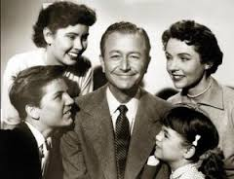

Sections of a Class Summary
private: “all mine – don’t touch”
protected: “keep it in the family”
public: “open to anyone”

Slide 23
Assignment Operators NOT Inherited
But are used in derived class definitions
Similar to how derived class constructor invokes base class constructor
Derived& Derived::operator =(const Derived & rightSide) { Base::operator =(rightSide); … }
Notice code line
Calls assignment operator from base class
This takes care of all inherited member variables
Would then set new variables from derived class…

Slide 24
Redefining vs. Overloading Differences
Redefining in derived class:
SAME parameter list
Essentially "re-writes" same function → But do new stuff
Overloading:
Different parameter list
Defined "new" function that takes different parameters
Overloaded functions must have different signatures (number and type of parameters)

Slide 25
Accessing Redefined Base Function
When redefined in derived class, base class’s definition not "lost"
Examples:
Employee JaneE; HourlyEmployee SallyH; JaneE.printCheck(); // calls Employee’s printCheck function SallyH.printCheck(); //calls HourlyEmployee printCheck function SallyH.Employee::printCheck(); //Calls Employee’s printCheck function!

Slide 26
Destructors
Opposite of constructor
Automatically called when object is out-of-scope {…}
Default version only removes ordinary variables, not dynamic variables
Defined like constructor, just add ~
MyClass::~MyClass() { //Perform delete clean-up duties }

Slide 27
Destructors in Derived Classes
When derived class destructor is invoked:
Make sure to de-allocate anything in derived class
Automatically calls base class destructor!
Explicit call to Base class needed when:
Base has pointer data

Slide 28
Destructor Calling Order
Consider: class B derives from class A class C derives from class B A ← B ← C
When object of class C goes out of scope:
Class C destructor called 1st
Then class B destructor called
Finally class A destructor is called
Opposite of how constructors are called

Slide 29
Destructor Practice
Modify Student class
Add an int property called numClasses
Add a dynamic char array called grades of size numClasses
Change student constructor to
numClasses = 4
Allocate space for dynamic array
Create new Student destructor
Use the delete command to free up the dynamic array space

Slide 30
Copy Constructors
Automatically called when:
Class object declared and initialized to other object
When function returns class type object
When argument of class type is "plugged in" as actual argument to call-by-value parameter
Requires "temporary copy" of object
Copy constructor creates it
Default copy constructor
Like default "=", performs member-wise copy
Pointers → write own copy constructor!

Slide 31
Copy Constructor Example
Consider: Derived::Derived(const Derived& Object) : Base(Object), … {…}
After : is invocation of base copy constructor
Sets inherited member variables of derived class object being created
Note Object is of type Derived; but it’s also of type Base, so argument is valid

Slide 32
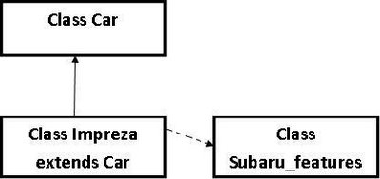
"Is a" vs. "Has a" Relationships
Inheritance
Considered an "Is a" class relationship
e.g., An HourlyEmployee "is a" Employee
A Convertible "is a" Automobile
Nested Classes
Class definition contains member variable of another class as it’s member data
Considered a "Has a" class relationship

Slide 33
Parent-Child Relations
“is a” vs. “has a”
Student
- name, ID
- getName( )
PhdStudent
- name, ID
- getName( )
- advisor
- getAdvisor( )
Undergrad
- name, ID
- getName( )
- major
- setMajor( )

Slide 34
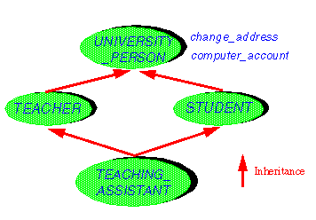
Multiple Inheritance
Derived class can have more than one base class!
Base classes separated by commas: class derivedMulti : public base1, base2 {…}
Possibilities for ambiguity are endless!
Dangerous undertaking!
Some believe should never be used
Certainly should only be used be experienced programmers!

Slide 35
Key Takeaways
Inheritance is a good thing!
Re-use code
Reduce errors
Model complex objects
Private versus Protected
Allows partial access to parent classes
Remember what cannot be inherited
Constructors
Operators

